Slide 1
ACErules forward chaining rule system based on attempto controlled english
Marković Miljan
3139/2011
miljan.markovic@gmail.com

Slide 2
Problem definition
Formal representation of knowledge
has become more important in human-computer interaction
There still exists a gap
between the ways humans and computers
represent knowledge
Humans use natural languages
Computers use formal languages
Humans need to translate their knowledge to computer
in order for computer to use it.

Slide 3
Problem importance
Developing knowledge specification techniques is crucial to make knowledge widely accessible to computers.
Without an easy way for human to formally represent knowledge,
a lot of it will remain inaccessible to vast processing powers of computers.

Slide 4
Problem trend
Better knowledge representation techniques
allow for more information input.
The more information is accessible to computers,
the more knowledge can be generated from it.
Rule engines already make a very good use
of existing knowledge,
providing for easier knowledge input
will allow them to be even more effective.

Slide 5
Existing solutions (1)
JBoss drools
Open source rule system written in java
Rules are expressed in java, python, MVEL and Groovy
Enterprise grade rule system
Good IDE integration
Still inaccessible to people who don’t have programming knowledge

Slide 6
Existing solutions (2)
OpenRules
Open source BDMS
Rules are stored in spreadsheets (Ms Excel)

Slide 7
Existing solutions (3)
BaseVIsor
versatile forward-chaining inference engine
specialized to handle facts in the form of RDF triples with support for OWL 2 RL and XML Schema Data types.

Slide 8
Proposed solution
ACERules is a rule engine that expresses it’s rules using controlled English language
It exposes a freely available web service.

Slide 9
Proposed solution
Attempto controlled English:
A subset of natural English language
ACE is a completely formal language
Every ACE sentence is syntactically valid English sentence, but not vice versa
This makes it ideal for knowledge presentation since practically anyone who knows English
can represent knowledge using ACE

Slide 10
Proposed solution
Knowledge represented in ACE
can easily be translated
into other formal representations.
OWL2 represented knowledge can be verbalized using ACE and ACE can be represented in OWL
There are many more translators implemented

Slide 11
Proposed solution
ACERules builds on top of ACE
to bring a rule engine everyone can use.
Like with ACE one must only know English to start using it.

Slide 12
Proposed solution
ACERules web interface
Program area
controls
Result area

Slide 13
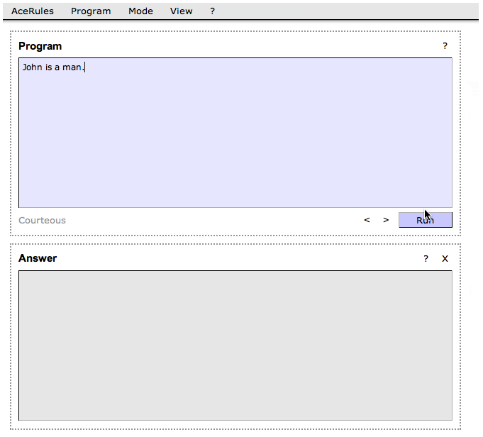
Proposed solution
ACERules web interface
Rules are written using ACE.
Clicking on Run button
starts rule processing

Slide 14
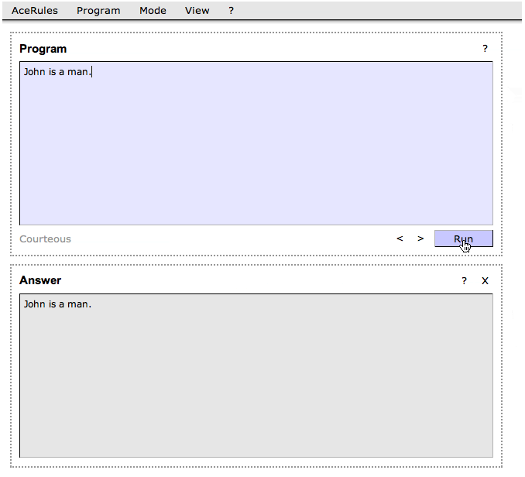
Proposed solution
ACERules web interface
Derived set of rules appears on the answer area

Slide 15
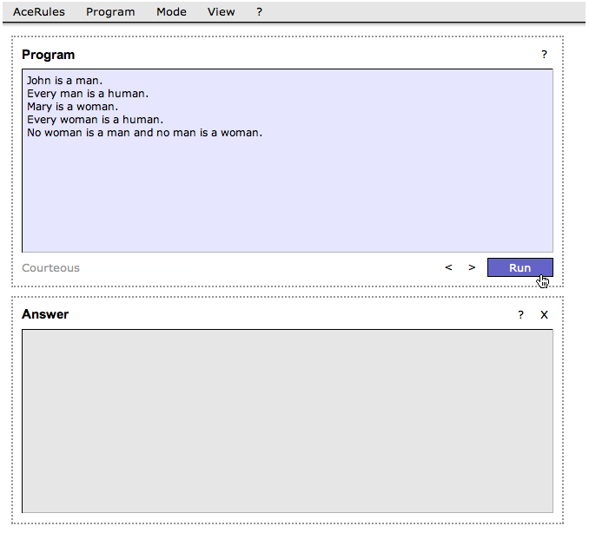
Proposed solution
ACERules web interface
Let’s make it a little more complex
Again clicking Run starts program

Slide 16
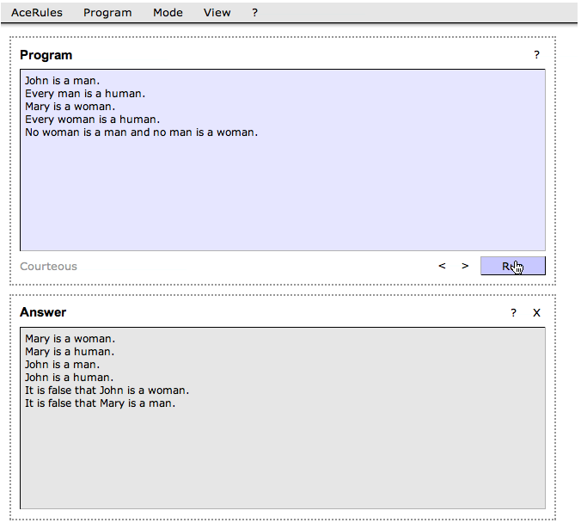
Proposed solution
ACERules web interface
Program is now able to figure out some new facts

Slide 17
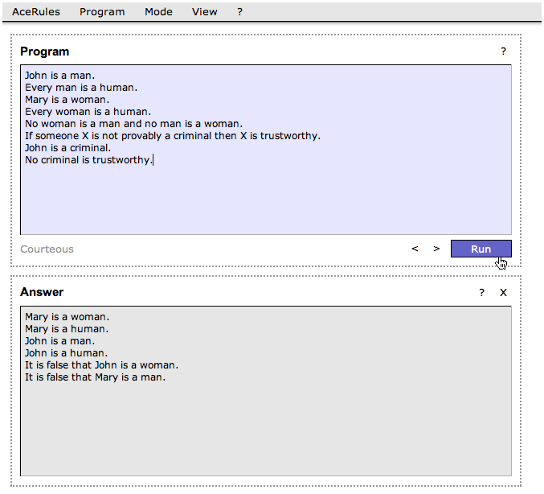
Proposed solution
ACERules web interface
Rules can be expressed with variables
“Not provably” expression can be used to express “negation as error”

Slide 18
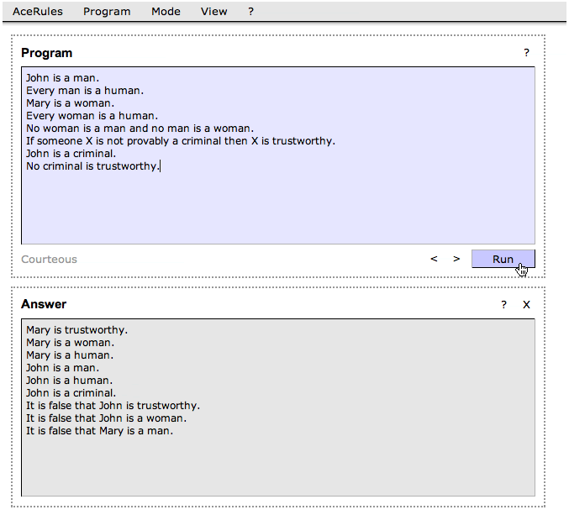
Proposed solution
ACERules web interface
Again a new set of rules is derived

Slide 19
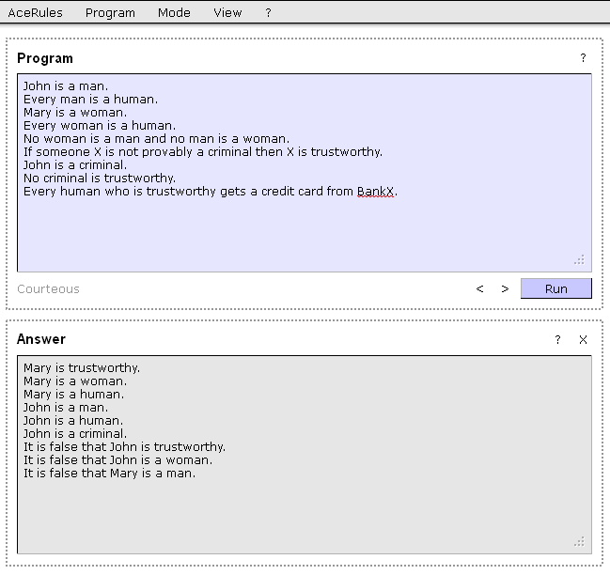
Proposed solution
ACERules web interface

Slide 20
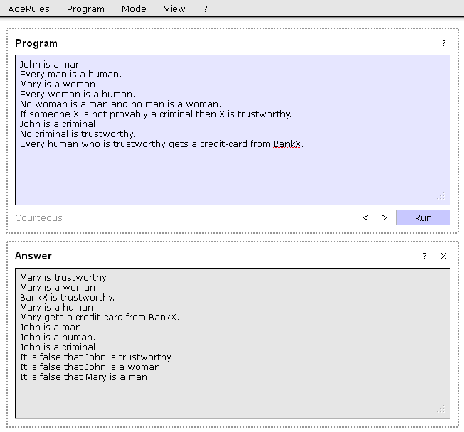
Proposed solution
ACERules web interface

Slide 21
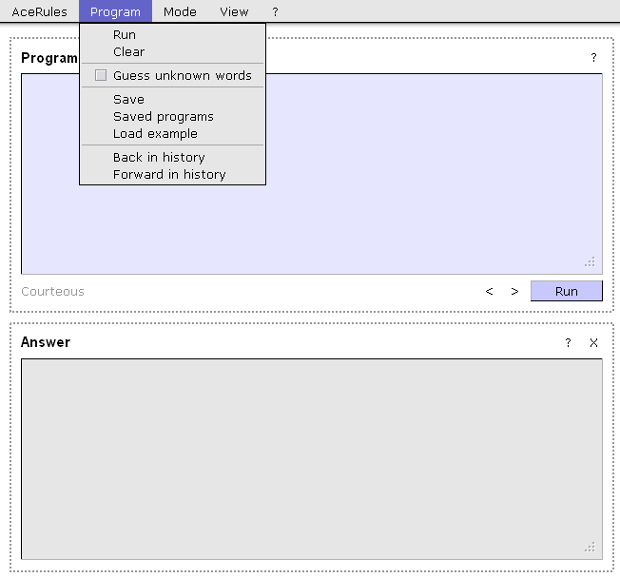
Proposed solution
ACERules web interface
Program menu can be used to load or save programs or to load examples.
There are also other basic controls.

Slide 22
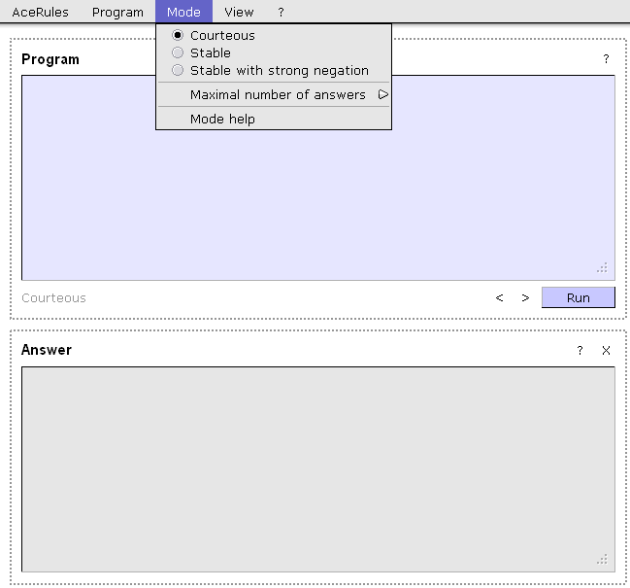
Proposed solution
ACERules web interface
AceRules currently operates in 3 modes
Courteous
Stable
Stable with strong negation.

Slide 23
Conclusion
ACERules is a rule resolving engine everyone can use
It is still a prototype, so there is more room for improvement

